Slide 1
Amazon Aurora
Lecturer: Ngo Huy Bien
Software Engineering Department
Faculty of Information Technology
University of Science
Ho Chi Minh City, Vietnam
nhbien@fit.hcmus.edu.vn

Slide 2

Objectives
To explain how Amazon Aurora works.

Slide 3

Contents

Slide 4

References
Alexandre Verbitski et al. (2017). Amazon Aurora - Design Considerations for High Throughput Cloud-Native Relational Databases.

Slide 5
Amazon Aurora
https://aws.amazon.com/rds/aurora/
Unparalleled high performance and availability at global scale with full MySQL and PostgreSQL compatibility.

Slide 6
Context
Distributed relational database management systems.

Slide 7
Problems
App/Web >> DB.
Crash >> Data loss.
Replication.
Limited CPU and RAM.
Limited storage.
Sharding.
Distributed file systems.

Slide 8


Slide 9
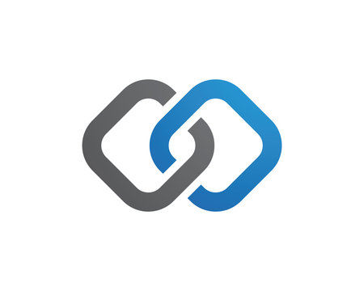
Database System Architecture
Refer to "Database Management Systems" >> "08.1. Database Storage.pptx"

Slide 10
Database System Architecture
https://timilearning.com/posts/mit-6.824/lecture-10-aurora/
Traditional relational databases comprise many units that work together:
the transport module which communicates with clients and receives queries,
the query processor which parses a query and creates a query plan to be carried out,
the execution engine which collects the results of the execution of the operations in the plan, and
the storage engine.

Slide 11
Database Storage Terminologies
https://timilearning.com/posts/data-storage-on-disk/part-one/
Disk I/O Operations: These are read and write operations that involve accessing your computer's physical disk.
Records: A row in your database table maps to a record on your computer's disk. Records can be of various sizes depending on the data contained in a row. There are different types of records, such as data records - say for storing an individual book in a database of books, index records, and records for other metadata about the database.
Pages: A page consists of many records. Pages have a fixed size which can be 4KB, 8KB, 16KB, etc. Two of the most popular page types are data pages and index pages. As you can imagine, data pages store data records and index pages store index records.

Slide 12
Records & Pages
When you add a new row to a database table using SQL, that row is converted internally to a record. Think of a record as an array of bytes, where each byte or group of bytes stores information about the record.
When this record is created, it is added to a page. Databases tend to work with pages. A page is the smallest unit of data that a database will load into a memory cache.
Imagine that a database needs to retrieve millions of records from disk and load them into memory. It would be difficult to determine how much space to allocate in memory for this operation. With pages, this becomes easier to manage since they are of a fixed length.

Slide 13
Dirty Pages
Saved records are first added to a page located in an in-memory cache.
Writeback is the process by which pages located in-memory are written back to disk.
When a page has two copies: one in memory and the other on disk, and the more recent page (the one in-memory) has been modified, the page is referred to as being dirty.
The content in-memory differs from what is on disk, and the content on disk needs to be updated since it is the durable data store.

Slide 14
Generic Transactional Database
Example bank transaction: Transfer $10 from x's account to y's account
x = x + 10
y = y - 10
Locks x and y, released after commit finishes.
Data in b-tree on disk.
Cached data pages.
DB server modifies only cached data pages as transaction runs and appends update info to WAL (Write-Ahead Log).

Slide 15
Transaction and Write-Ahead Log
LSID TID key old new
101 7 x 500 510 (generated by x = x + 10)
102 7 y 750 740 (generated by y = y - 10)
103 7 commit (transaction finished)
Commit once WAL safe on disk.
Release locks on x and y.
Reply to client.
Later write modified data pages from cache to disk.
To free log space, allow cache eviction.
Crash recovery
Replay "new" values for all committed transactions in log (redo).
Replay "old" values for uncommitted transactions in log (undo).

Slide 16
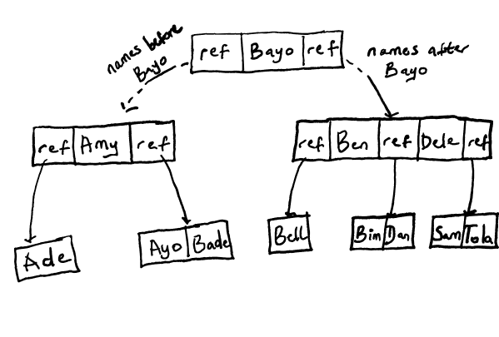
Terminologies
https://timilearning.com/posts/data-storage-on-disk/part-two/
Heap: Records are identified by a row ID (RID) which is a pointer made up of the file ID, page ID and slot ID that the record is located on, represented as (FileID:PageID:SlotID).
Indexes: B-Trees, B+ Trees

Slide 18
Amazon EC2 and EBS
EBS is not shared storage.
One instance: DB >> EBS
Limited CPU and RAM, and storage.
Two or more than two instances:
lots of data sent over network -- both log and dirty data pages
two replicas not enough, but a chain with more would be too slow!
both replicas are in same AZ -- vulnerable to fire, flood, power failure, broken Internet connection

Slide 19
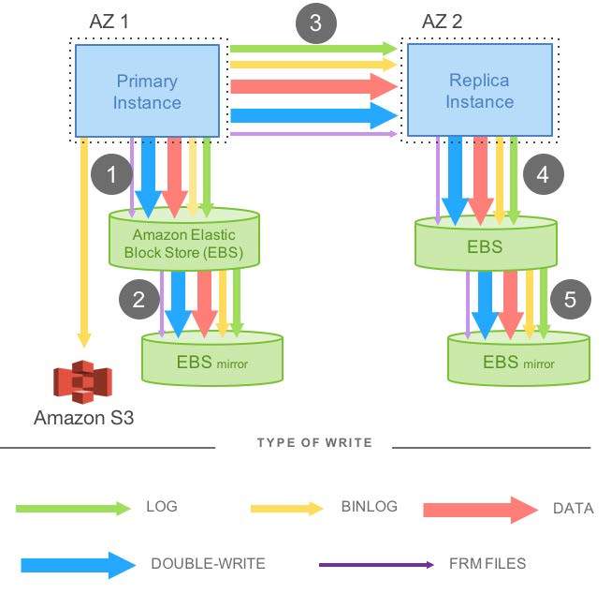
Mirrored MySQL [1]
There is an active MySQL instance in AZ1 with networked storage on Amazon Elastic Block Store (EBS).
There is also a standby MySQL instance in AZ2, also with networked storage on EBS.
The writes made to the primary EBS volume are synchronized with the standby EBS volume using software mirroring.

Slide 20
Network IO in mirrored MySQL
The various types of data that the engine needs to write: the redo log, the binary (statement) log that is archived to Amazon Simple Storage Service (S3) in order to support point-in-time restores, the modified data pages, a second temporary write of the data page (double-write) to prevent torn pages, and finally the metadata (FRM) files.
In MySQL (before 8.0), an .frm file is the table-definition (metadata) file.

Slide 21
Transaction Commit
When a traditional database modifies a data page, it generates a redo log record and invokes a log applicator that applies the redo log record to the in-memory before-image of the page to produce its after-image.
Transaction commit requires the log to be written, but the data page write may be deferred.

Slide 22
Offloading Redo Processing to Storage
In Aurora, the only writes that cross the network are redo log records.
No pages are ever written from the database tier, not for background writes, not for checkpointing, and not for cache eviction.
Instead, the log applicator is pushed to the storage tier where it can be used to generate database pages in background or on demand.
Of course, generating each page from the complete chain of its modifications from the beginning of time is prohibitively expensive.
We therefore continually materialize database pages in the background to avoid regenerating them from scratch on demand every time.

Slide 23
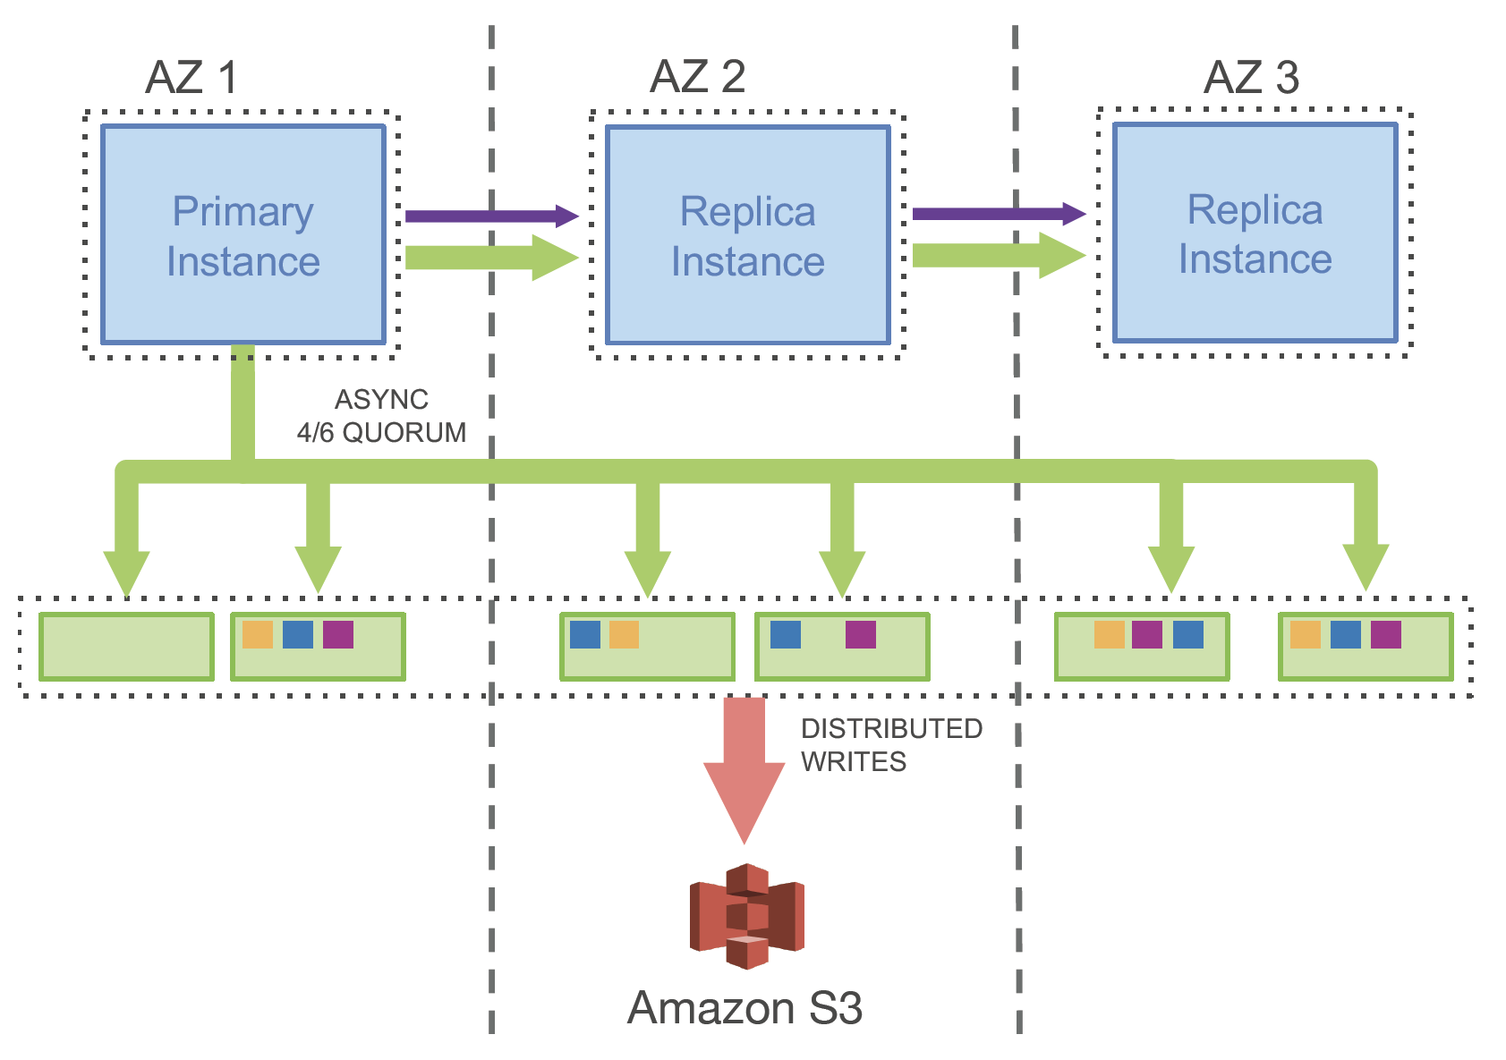
Network IO in Amazon Aurora
An Aurora cluster with one primary instance and multiple replicas instances deployed across multiple AZs.

Slide 24
Writing Only Log Records
The primary only writes log records to the storage service and streams those log records as well as metadata updates to the replica instances.
The IO flow batches fully ordered log records based on a common destination (a logical segment, i.e., a PG) and delivers each batch to all 6 replicas where the batch is persisted on disk and the database engine waits for acknowledgements from 4 out of 6 replicas in order to satisfy the write quorum and consider the log records in question durable or hardened.
The replicas use the redo log records to apply changes to their buffer caches.

Slide 25
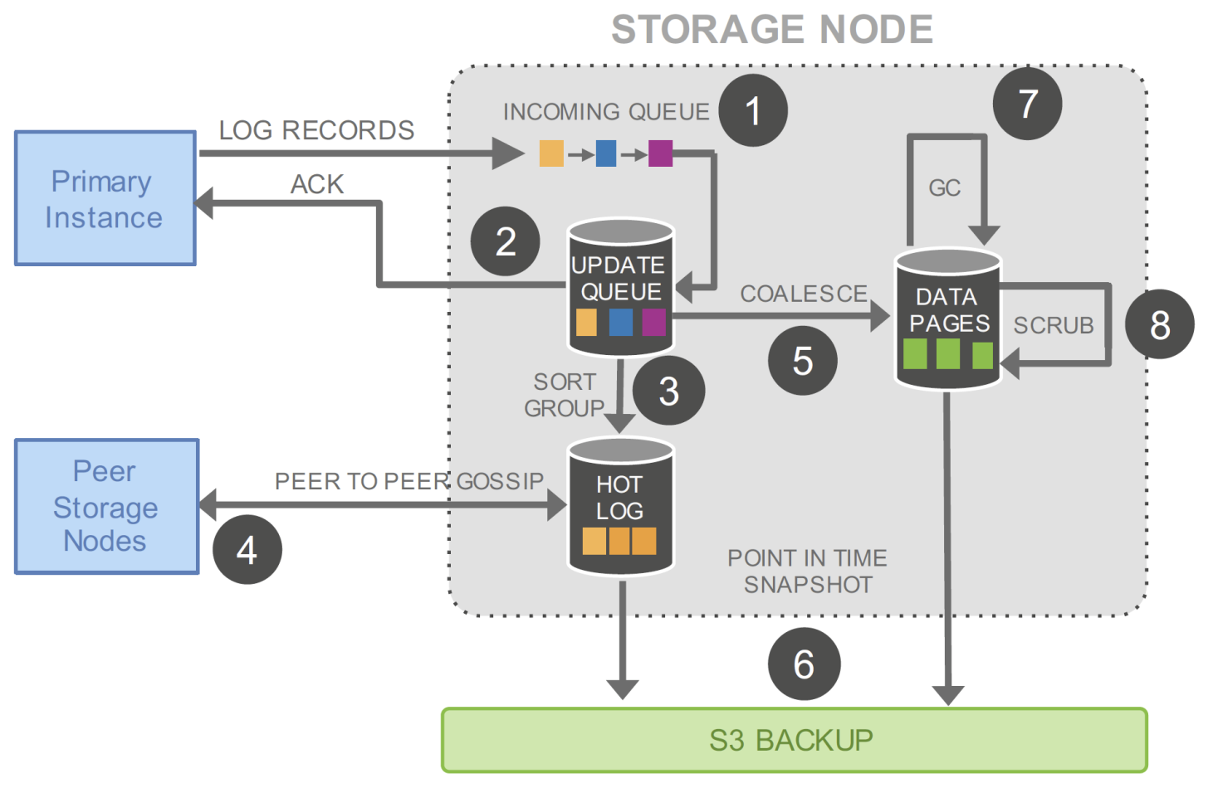
Aurora Storage Nodes

Slide 26
IO Traffic in Aurora Storage Nodes
(1) receive log record and add to an in-memory queue,
(2) persist record on disk and acknowledge,
(3) organize records and identify gaps in the log since some batches may be lost,
(4) gossip with peers to fill in gaps,
(5) coalesce log records into new data pages,
(6) periodically stage log and new pages to S3,
(7) periodically garbage collect old versions, and finally
(8) periodically validate CRC codes on pages.
Note that not only are each of the steps above asynchronous, only steps (1) and (2) are in the foreground path potentially impacting latency.

Slide 27
Quorum-based Voting Protocol
If each of the V copies of a replicated data item is assigned a vote, a read or write operation must respectively obtain a read quorum of V_{r} votes or a write quorum of V_{w} votes.
To achieve consistency, the quorums must obey two rules.
First, each read must be aware of the most recent write, formulated as V_{r} + V_{w} > V.
This rule ensures the set of nodes used for a read intersects with the set of nodes used for a write and the read quorum contains at least one location with the newest version.
Second, each write must be aware of the most recent write to avoid conflicting writes, formulated as V_{w} > V/2.

Slide 28
Replication and Correlated Failures
A common approach to tolerate the loss of a single node is to replicate data to (V = 3) nodes and rely on a write quorum of 2/3 (V_{w} = 2) and a read quorum of 2/3 (V_{r} = 2).
In Aurora, we have chosen a design point of tolerating
(a) losing an entire AZ and one additional node (AZ+1) without losing data, and
(b) losing an entire AZ without impacting the ability to write data.
We achieve this by replicating each data item 6 ways across 3 AZs with 2 copies of each item in each AZ.
We use a quorum model with 6 votes (V = 6), a write quorum of 4/6 (V_{w} = 4), and a read quorum of 3/6 (V_{r} = 3).

Slide 29
Sufficient Durability
To provide sufficient durability in this model, one must ensure the probability of a double fault on uncorrelated failures (Mean Time to Failure – MTTF) is sufficiently low over (during) the time it takes to repair one of these failures (Mean Time to Repair – MTTR).
If the probability of a double fault is sufficiently high, we may see these (double faults) on an AZ failure, breaking quorum.
It is difficult, past a point, to reduce the probability of MTTF on independent failures.
We instead focus on reducing MTTR to shrink the window of vulnerability to a double fault.
A double fault (in quorum-based or replicated systems) means two independent failures occur before the first one has been repaired, reducing the system below the required replication quorum.

Slide 30
Protection Groups
We do so by partitioning the database volume into small fixed size segments, currently 10GB in size.
These are each replicated 6 ways into Protection Groups (PGs) so that each PG consists of six 10GB segments, organized across three AZs, with two segments in each AZ.

Slide 31
Storage Volumes
A storage volume is a concatenated set of PGs, physically implemented using a large fleet of storage nodes that are provisioned as virtual hosts with attached SSDs using Amazon Elastic Compute Cloud (EC2).
The PGs that constitute a volume are allocated as the volume grows.
We currently support volumes that can grow up to 64 TB on an unreplicated basis.

Slide 32
Repairing Faults
Segments are now our unit of independent background noise failure and repair.
We monitor and automatically repair faults as part of our service.
A 10GB segment can be repaired in 10 seconds on a 10Gbps network link.
We would need to see two such failures in the same 10 second window plus a failure of an AZ not containing either of these two independent failures to lose quorum.
At our observed failure rates, that's sufficiently unlikely, even for the number of databases we manage for our customers.

Slide 33
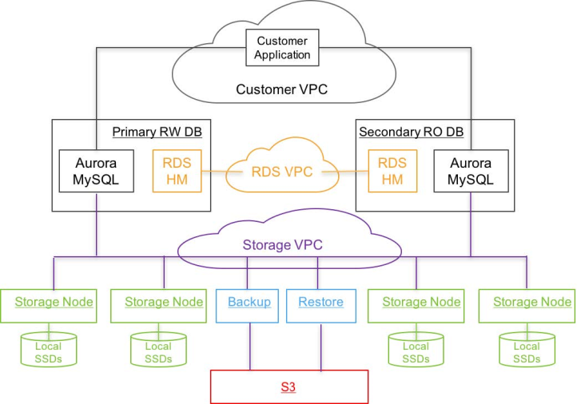
Aurora Architecture

Slide 34
The Host Manager (HM)
Aurora leverages Amazon Relational Database Service (RDS) for its control plane.
RDS includes an agent on the database instance called the Host Manager (HM) that monitors a cluster’s health and determines if it needs to fail over, or if an instance needs to be replaced.
Each database instance is part of a cluster that consists of a single writer and zero or more read replicas.
The instances of a cluster are in a single geographical region (e.g., us-east-1, uswest-1 etc.), are typically placed in different AZs, and connect to a storage fleet in the same region.

Slide 35
The VPCs
For security, we isolate the communication between the database, applications and storage.
In practice, each database instance can communicate on three Amazon Virtual Private Cloud (VPC) networks:
the customer VPC through which customer applications interact with the engine,
the RDS VPC through which the database engine and control plane interact with each other, and
the Storage VPC through which the database interacts with storage services.

Slide 36
The Storage Service
The storage service is deployed on a cluster of EC2 VMs that are provisioned across at least 3 AZs in each region and is collectively responsible for provisioning multiple customer storage volumes, reading and writing data to and from those volumes, and backing up and restoring data from and to those volumes.
The storage nodes manipulate local SSDs and interact with database engine instances, other peer storage nodes, and the backup/restore services that continuously backup changed data to S3 and restore data from S3 as needed.

Slide 37
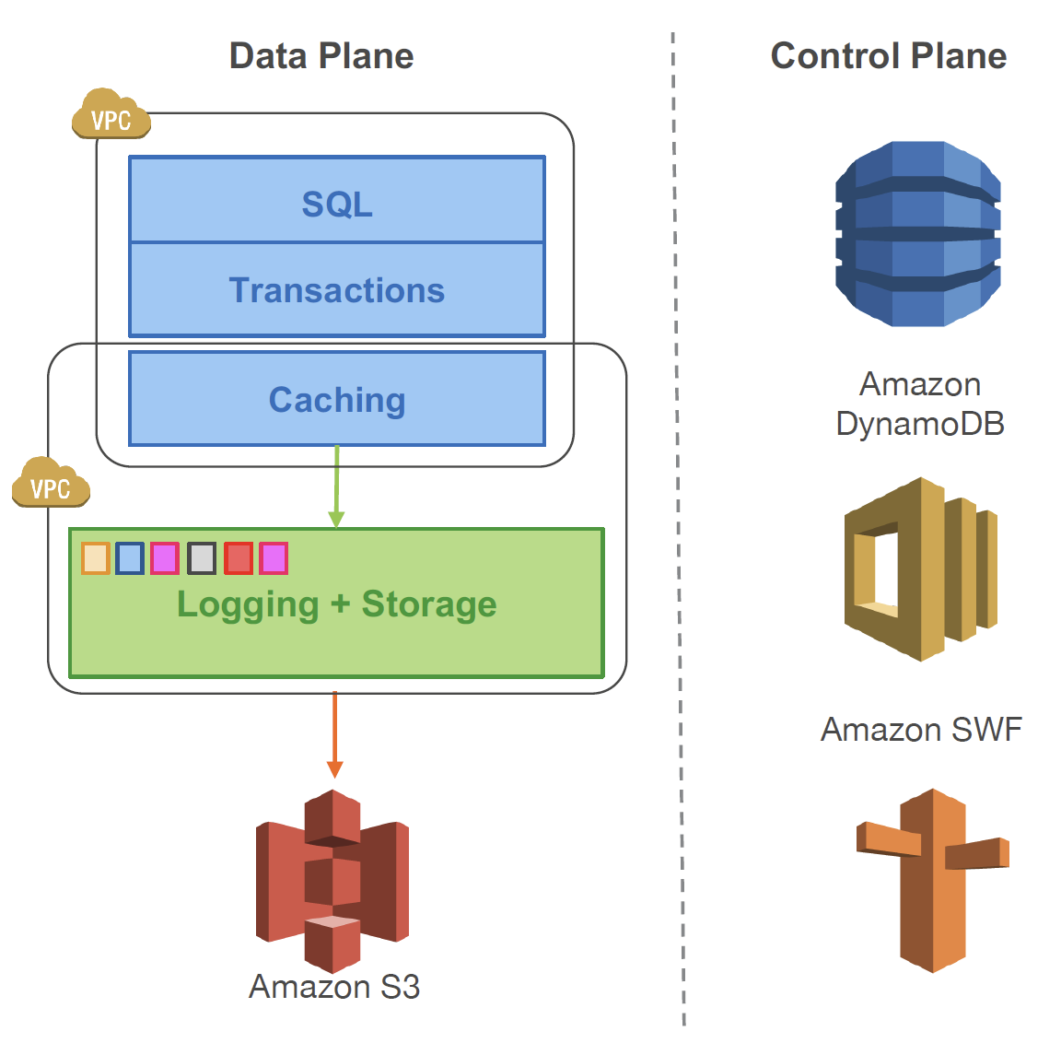
The Storage Control Plane
The storage control plane uses the Amazon DynamoDB database service for persistent storage of cluster and storage volume configuration, volume metadata, and a detailed description of data backed up to S3.
For orchestrating long-running operations, e.g. a database volume restore operation or a repair (re-replication) operation following a storage node failure, the storage control plane uses the Amazon Simple Workflow Service.

Slide 38

Thank You & See You Again

